Slide 1

Group 3 Hackathon
Engila Saidy
Anna Gibson
Francisco Giordana-Silva
Louisa Stratton
Reuben Seager
Andrew Buchanan
July 2022

Slide 2


AGENDA
1 | Problem
2 | Dataset
3 | Modelling And Evaluation
4 | Q&A

Slide 3
Problem
Israeli COVID-19 PCR Data With Corresponding Symptoms as Features
In order to maximise available healthcare resources in countries with poorer access to public services we will build a model that allows health practitioners to more effectively triage potential covid-19 patients

Slide 4
Data
Data and features
Data set contains two years of PCR tests and corresponding symptoms as features
These features include:
Age
Gender
Cough, fever, sore throat, shortness of breath, headache, positive covid-contact
Indexed using date
Gathered external data from OurWorldInData for additional features
'new_cases_smoothed_per_million_lag’,
'reproduction_rate_lag’,
'weekly_icu_admissions_per_million_lag’,
'weekly_hosp_admissions_per_million_lag’,
'stringency_index_lagged'

Slide 5
Data
Considerations
The data is class imbalanced towards negative tests
Data is from a single country – Israel is a high HDI country, and therefore economically more developed, could models trained on data from less developed countries be explained by different features for example
Symptoms can vary in severity, but we do not have severity data
Gender and age contain a large number of NAs

Slide 6
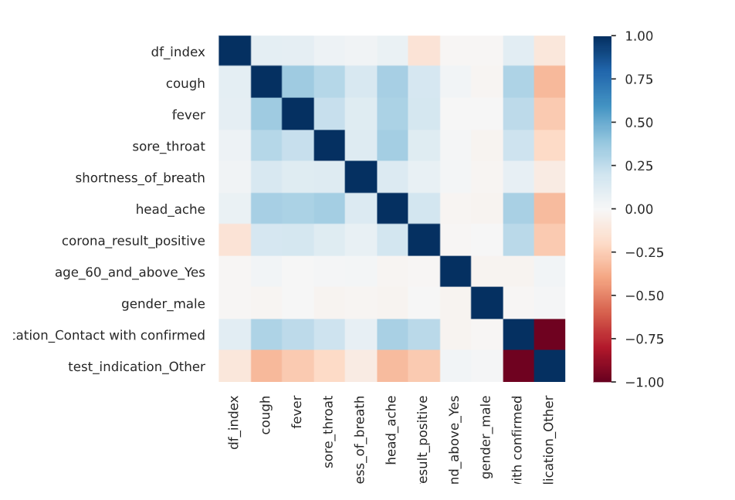
Data
Corrplot
Intuitively linked features are shown to be most positively correlated with one another
These include cough, fever, sore throat, shortness of breath and headache
These are also reasonably positively correlated with the target variable as well

Slide 7
Data
Pre-processing
First step of pre-processing was to select the most recent 6 months of data
Make sure that symptom features are relevant to the most recent form of COVID
Minimise model training time
Remove features with large proportion of NaNs: Age, Gender
Removed “Other” from corona_result feature
Two forms of train, test, split
Randomised, time based
Scaled data using MinMaxScaler, after splitting the data to avoid data leakage

Slide 8
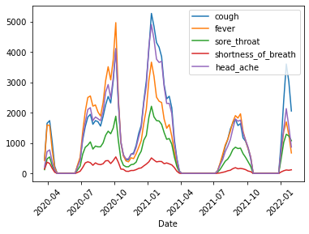
Data
Symptom Prevalence Over Time Amongst Positive Cases
Prevalence by symptom changes over time
Fever is more prevalent in earlier strains of Covid

Slide 9
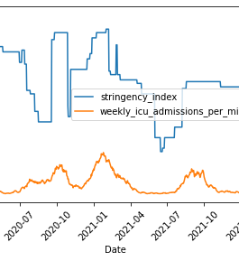

Data
Stringency Index
We have assumed that control measures were reactive, and increased with an increase in cases.
As there is a lag between infection and presentation of symptoms (and therefore testing), the Stringency Index (SI) at the point of infection is more important.
Therefore we have shifted the SI by 7 days so that the model can train on what the SI was at the time of a test case being positive. This means the feature will be more useful.

Slide 10
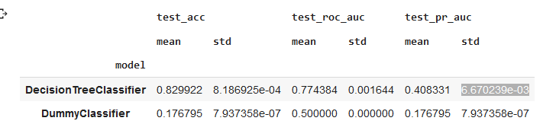
Modelling
Baseline on the randomised training data
Two baseline models were fit to our training and testing data
The first model was a naïve dummy classifier
The naïve dummy classifier predicts all observations as being positive
The second baseline model was a Decision Tree Classifier

Slide 11
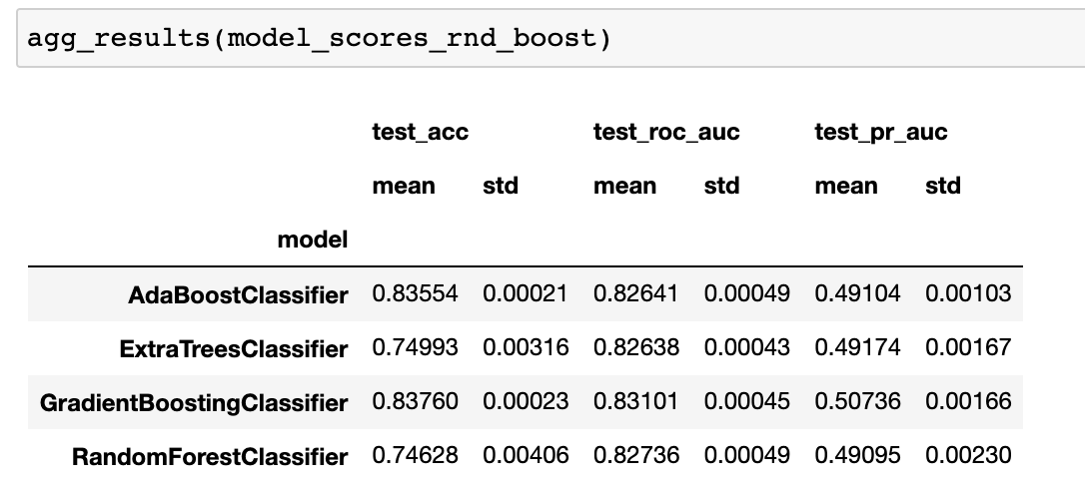
Modelling
Gradient Boosted Trees – Random Sampling
Summarises the scores of 9 runs
GradientBoostingClassifier performs best in terms of test_pr_auc and lowest standard deviation

Slide 12
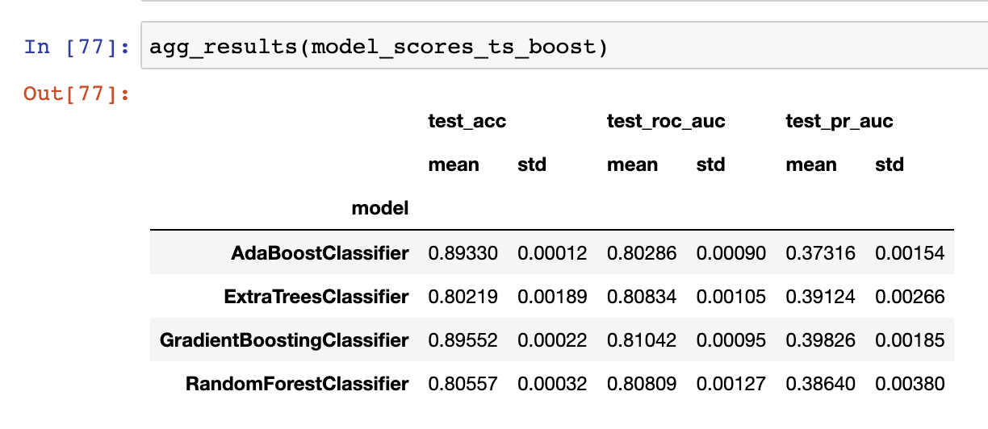
Modelling
Gradient Boosted Trees – Time Based Sampling
Using the same approach as the randomised sampling, we find a poorer fit to the training data using the time based splits

Slide 13
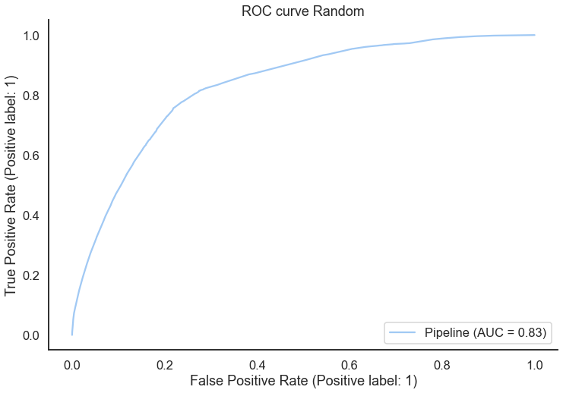
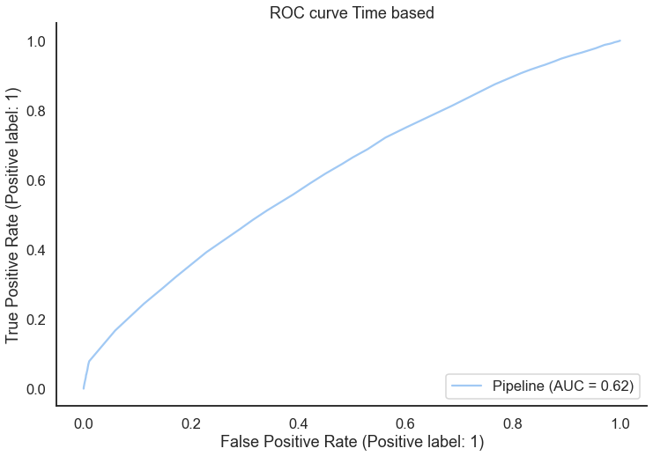
Modelling
Predicting on the test partition of randomised data using GradientBoostingClassifier
When zoning in on the GradientBoostingClassifier, we find that the model performs far better on the randomised data as opposed to the time based data

Slide 14
For future testing
SHAP values to confirm whether our exogenous variables are contributing to model quality
GridSearchCV for further hyperparameter tuning
PCA for improving model times at the expense of model accuracy
Existing approach left deterministic features in the model, which could as per paper be biasing our results

Slide 15
Q&A

